Slide 1
ECE 313: PROBABILITY WITH ENGINEERING APPLICATIONS
Fall 2023
Prof. Eric Chitambar
Lecture 29

Slide 2
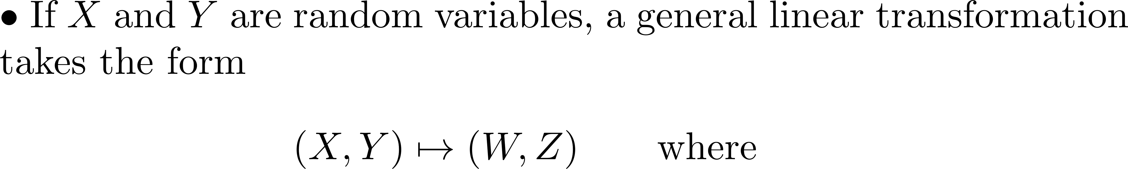
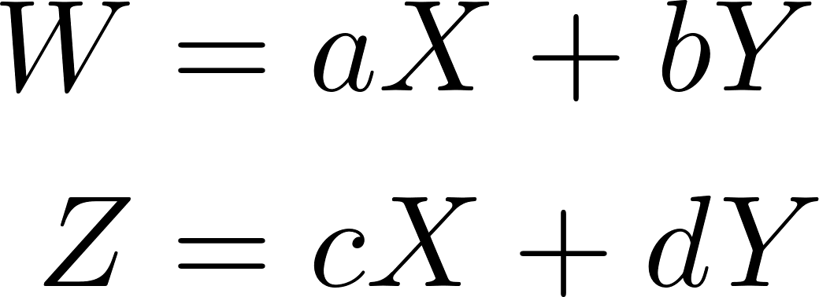
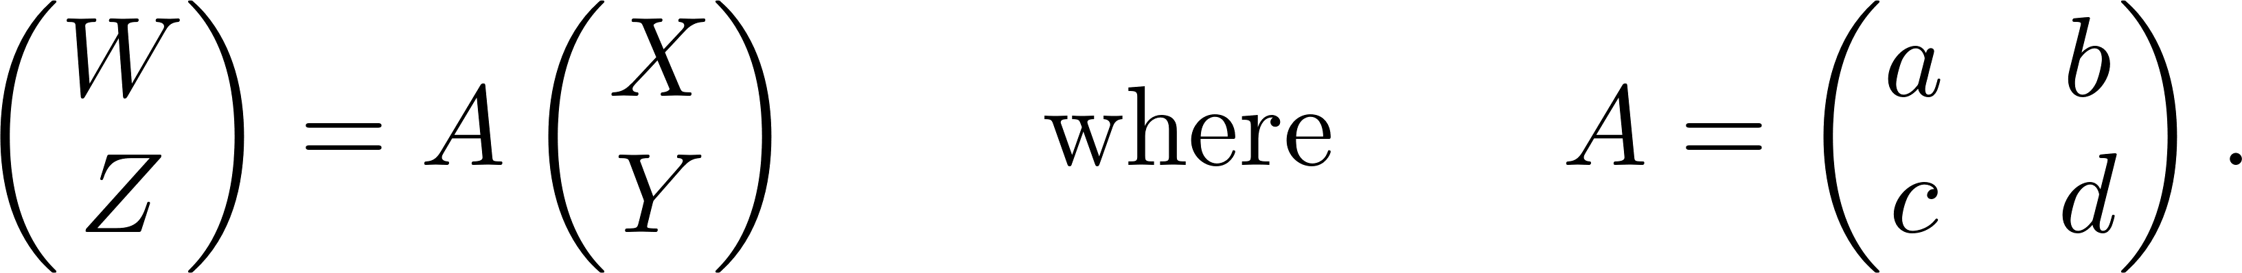
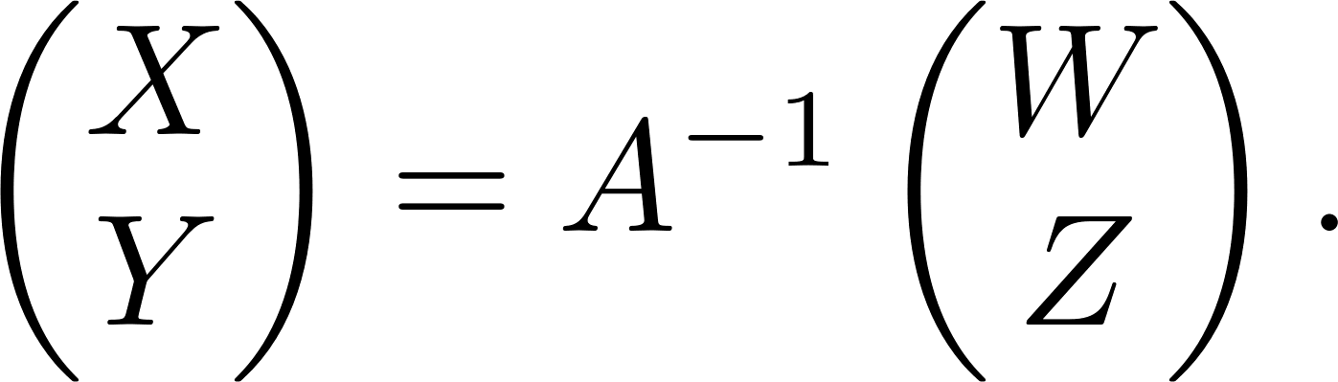
Linear Transformation of Joint R.V.s

Slide 3
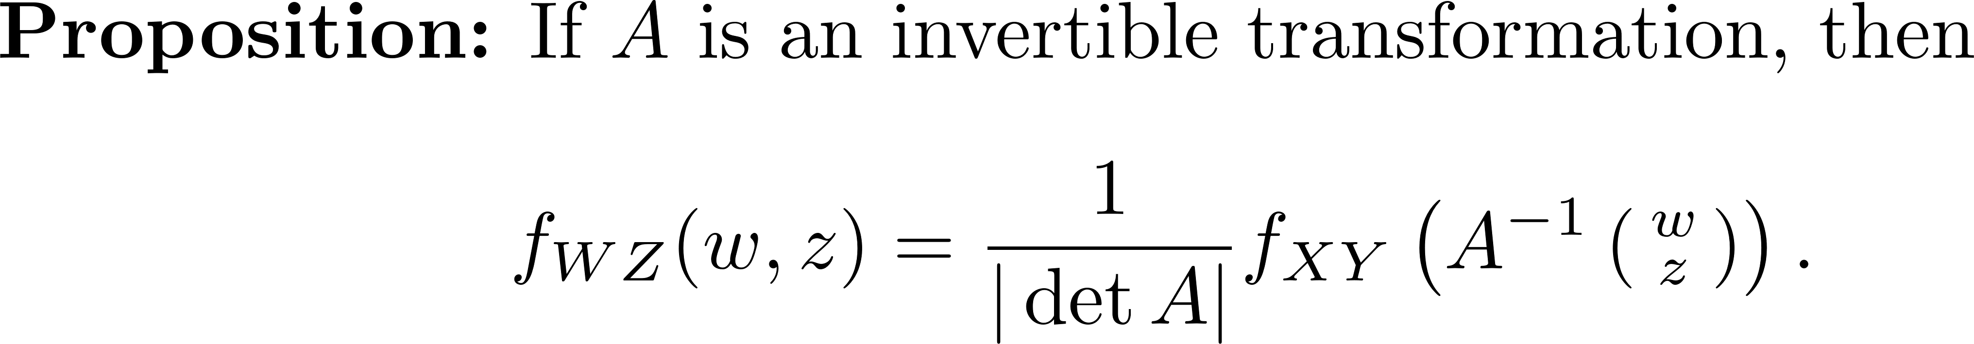
Linear Transformation of Joint R.V.s

Slide 4
Correlation and Covariance

Slide 5
Correlation and Covariance

Slide 6
Correlation and Covariance

Slide 7
Correlation and Covariance

Slide 8
Correlation and Covariance

Slide 9
Correlation and Covariance

Slide 10
Correlation and Covariance

Slide 11
Correlation and Covariance

Slide 12
Correlation and Covariance

